Slide 1
Real Estate Growth Mapping using Tableau Module 3: Business
Kenneth Hua

Slide 2
Project scope
My REIT (Real-estate) needs to determine the top 5 areas with the highest growth in housing prices to know where to target their investments and development projects.
The impact hypothesis is that current market trends will continue, and that areas with high, sustained growth will continue to demonstrate strong growth in the next 5-10 years.
Risks: Economic uncertainties, natural disasters, pandemics, social factors

Slide 3
Methodology
Using Zillow Open DataSet, we obtained housing price data from 2000-2021.
We calculated the difference between each year, to obtain the percentage change year to year
We averaged the year to year change from 2012-2021 to find the Average Year to Year Change, the metric we use to determine the highest growth Metropolitan Areas in the U.S

Slide 4
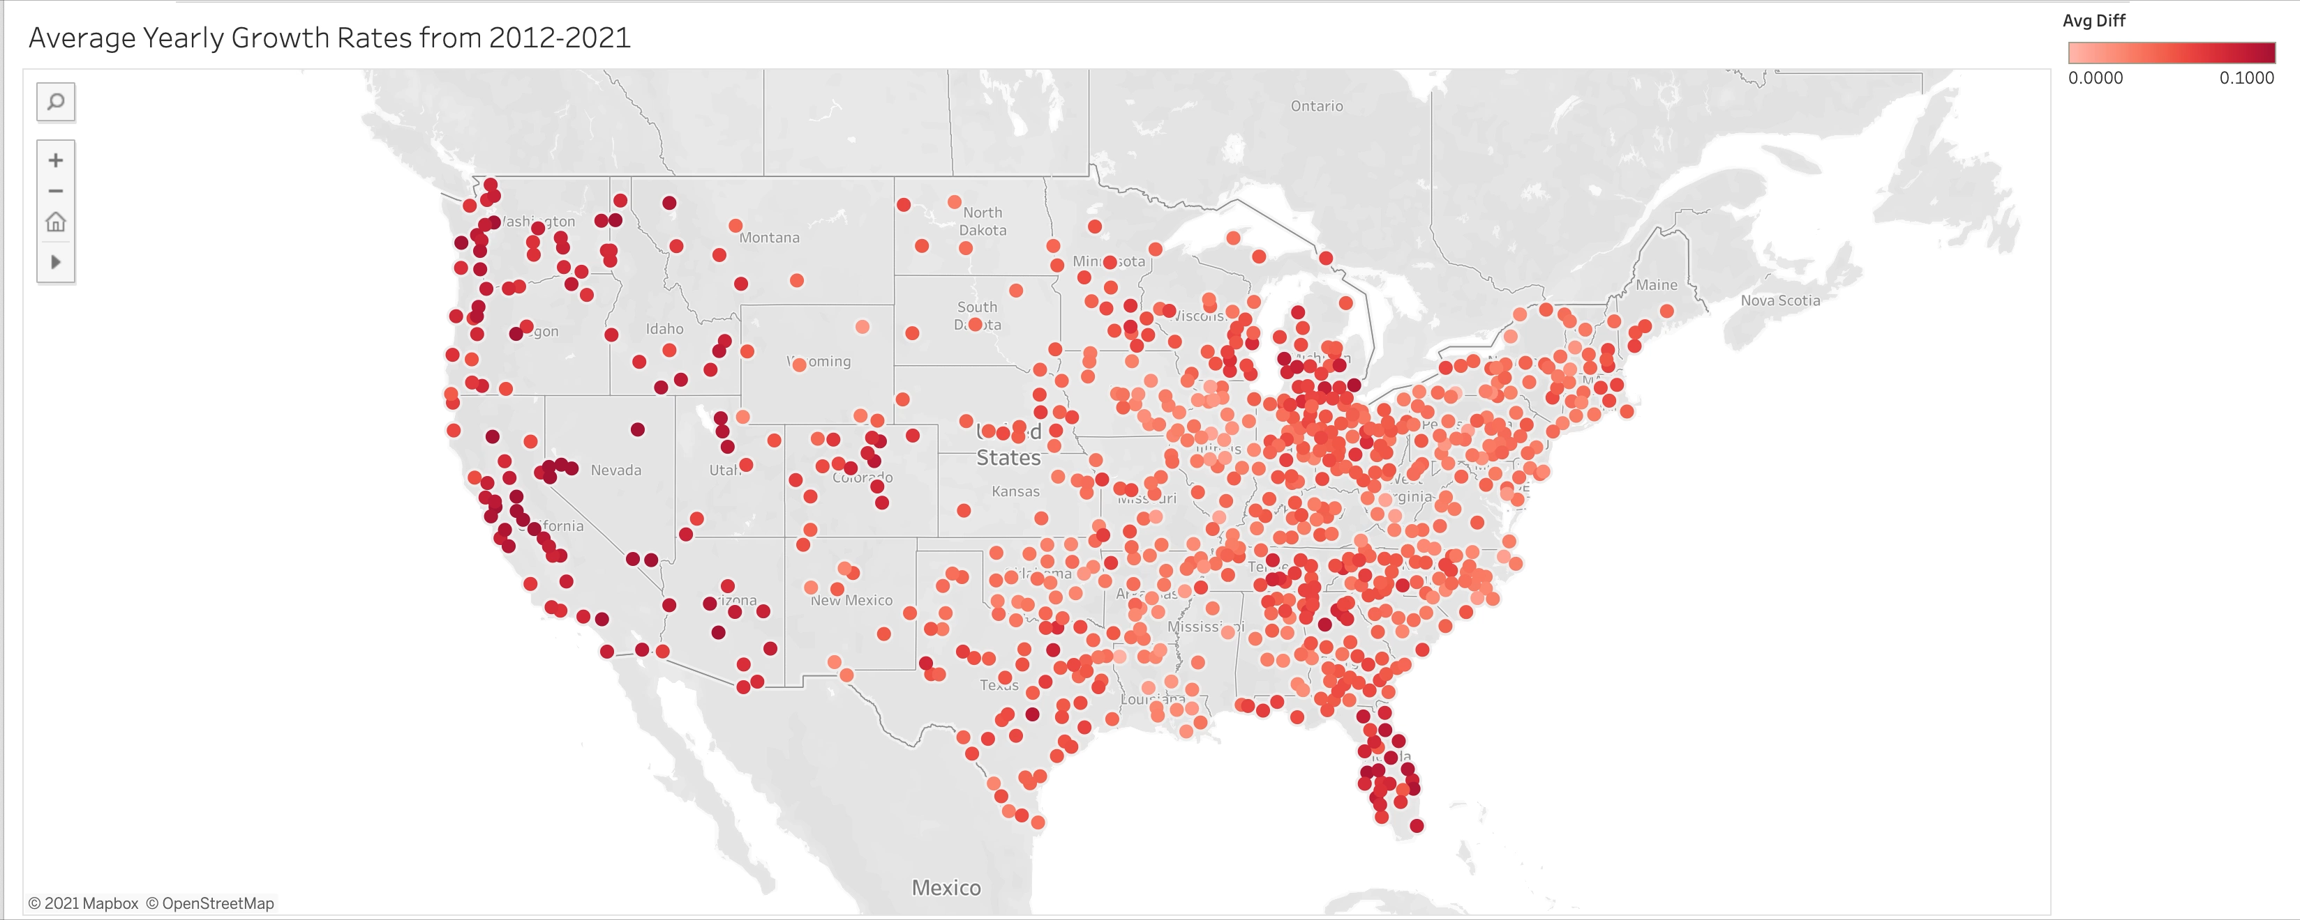
High growth areas are typically located in the Western Region, Florida, and parts of Michigan
Low growth areas are typically located in the Midwest, Northeast, and South

Slide 5
Top Growth Areas
Top growth areas are typically located in the Western Region (CA Central Valley, Mountain West)
High growth areas have a average YTY growth rate of ~9-13%, compared to the U.S average of 5.5%

Slide 6
Bottom Growth Areas
Bottom growth areas are typically located in the Midwest, Northeast, and South.
There are some regions with negative growth rates, but most of the low growth rate regions are stagnating in price, but not decreasing.

Slide 7
Yearly Housing Price (2012-2021)
Top Growth cities vastly outperformed U.S average from 2012-2021
A house in Boise, ID bought for $149,805 in 2012 is now valued at $444,386 in 2021 (196% growth)
Low Growth cities stagnated in price

Slide 8
Conclusions:
The 4 highest growth areas:
Boise, ID
Merced, CA
Stockton, CA
Reno, NV
Modesto, CA
The Western Region of the country on average has the highest growth rates compared to other regions
REIT can start planning investments in the Metropolitan areas identified above, and should start to build a base of operations in the Western Region of the country

Slide 9
Next Steps:
Do more market and geographical research on the 5 areas identified to account for other risks
Build predictive model using time-series modeling, to have a more rigorous model for price prediction
Incorporate feedback from stakeholders and other project members to iterate on the current analysis

